Slide 1
Depression and Chronic Pain in Older Adults
Notes:
In older adults, chronic pain and depression can occur together and have many overlapping features, including:
Social isolation
Sleep disturbance
Poor functioning in activities of daily life
Malnutrition
Problems with thinking
Source: http://www.healthinaging.org/aging-and-health-a-to-z/topic:depression/info:unique-to-older-adults/

Slide 2
Depression Symptoms
Sleep problems (too much/little)
Anhedonia: lack of interest or pleasure in activities
Excess guilt
Low energy
Poor concentration
Increased/decreased appetite
Psychomotor agitation
Suicidal thoughts

Slide 3
Depression Signs in Older Adults
Memory problems
Social withdrawal
Less likely to report depressed mood
Loss of appetite
Weight loss
Inability to sleep
Irritability
Hallucinations
Vague complaints of pain
Notes:
In older adults, depression signs can be non-specific and mimic symptoms of alternative or co-occurring illnesses. This is further complex because older adults are more likely to report loss of interest in previously enjoyed activities, and less likely to endorse depressed mood, particularly in men.
For instance, weight loss and social withdrawal can be due to depression, but might also be signs of cancer; and hallucinations are seen in some forms of dementia (e.g. Lewy body dementia).
Anticipate and look for depression to be more common in older adults who present with other illnesses, thus highlighting the prevalence of multiple chronic conditions in this population.
Many older adults report experiencing physical pain as part of depression, or experience depression in reaction to chronic pain.

Slide 4
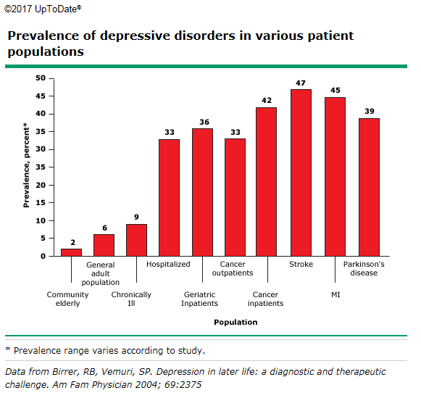
Depression is not a normal consequence of aging
Notes:
Healthy community-living older adults have lower rates of major depression than the general population. Rates increase with more chronic diseases. Among those with depression, suicide rates are almost twice as high in older adults, and they are highest for white men over 85 years old.
Source: https://www.uptodate.com/contents/diagnosis-and-management-of-late-life-unipolardepression?source=search_result&search=depression%20elderly&selectedTitle=1~150#H1

Slide 5
Risk Factors for Late-Life Depression
Female
Social isolation
Widowed, divorced, or separated
Lower socioeconomic status
Comorbid general medical conditions
Uncontrolled pain
Insomnia
Functional impairment
Cognitive impairment
Notes:
The list on the slide represents risk factors for late-life depression that are important to consider when working with older adults.
According to the study by Cole and Dendukuri, bereavement, sleep disturbance, disability, prior depression, and female gender appear to be important risk factors for depression among elderly community subjects.
Source: Cole MG, Dendukuri N. Risk factors for depression among elderly community subjects: a systematic review and meta-analysis. Am J Psychiatry 2003; 160:1147.

Slide 6
Why is Pain Harder to Assess in Older Adults?
False belief that pain is normal aging
Fear that pain complaints leave less time for “medical” complaints
Pain terms used by older adults (“sore, discomfort”, etc.) can be missed by some pain screening instruments
Sensory and cognitive impairments complicate pain assessment
Notes:
Chronic pain is more prevalent in older adults:
76% of community living older adults
93% in long-term care facilities
However, the bullet points on the screen represent a few barriers to diagnosing it.
Source:
Abdulla, A., Bone, M., Adams, N., Elliott, A.M., Jones, D., Knaggs, R., Martin, D., Sampson, E.L., & Schofield, P. (2013). Evidence-based clinical practice guidelines on management of pain in older people. Age Ageing, 42 (2), 151-153. doi: 10.1093/agein.
https://www.uptodate.com/contents/evaluation-of-chronic-pain-in-adults?source=machineLearning&search=pain%20elderly&selectedTitle=6~150&sectionRank=1&anchor=H15544523#H15544523

Slide 7
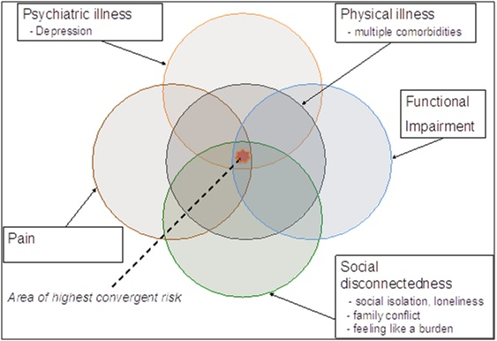
Pain, Depression, and Chronic Conditions Converge to Increase Suicide Risk
Notes:
The convergence of factors such as depression, pain, multiple comorbidities (such as diabetes, arthritis, and cancer), functional impairment, and social isolation, all increase the risk for suicide in older adults.
Source: Kimberly Van Orden, PhD, University of Rochester Medical Center via http://gerocentral.org/clinical-toolbox/clinical-issues/suicide-2/

