Slide 1
Caregiving

Slide 2
Caregiving
15 million caregivers in the U.S.
  85% are family members
18 billion hours of care provided by caregivers
  Valued at $220 billion
Identify family members and involve early
  Not just biological families (friends, neighbors, families of choice)
Family caregiving team members share the same goal
Bidirectional communication between family caregiving team and health care team
Notes:
There are more than 15 million dementia caregivers and 85% are family members. Dementia caregivers provide over 18 billion hours of care valued at $220 billion.
With a growing number of caregivers caring for person’s living with dementia it is important to involve family members and other caregivers as early as possible. The role of caregiver can become isolating without additional help. Although early family involvement is ideal, it is important to meet each member where they are. Involving family members keeps everyone informed while allowing members to define their individual contributions. Distance family members may be limited due to their location yet may contribute financially or in other ways. Similarly, family members living close by may be involved more frequently while needing additional help so that they do not become overwhelmed by the stress of constant caregiving.
Remember, the term ‘family caregivers’ is a term defined by each family. While some family caregivers may be biological family members, this can extend to neighbors, friends, religious/church…virtually anyone that is considered “family”. The important thing is not how family caregiver is defined, but that those who are considered family are identified and, have the opportunity to become involved.
The family caregiving team includes family members and other individuals who share the same goal. The caregiving team may include support services such as community agencies as well as the interprofessional health care team which may include, but is not limited to the geriatrician, psychiatrist, neurologist, nurse practitioner, physician assistant, social worker, registered nurse, pharmacist, community agency staff. Defining the team will help identify who needs to be involved and when…not all members of the team will be involved immediately or for the duration of the disease process.
The roles of health care team members are usually more explicit, while the roles of other team members (family) may overlap. Caregivers are balancing multiple aspects of caregiving such as assisting with care, providing support, and/or coordinating and managing health care services and so much more. Some team members may be better at providing emotional, financial, or social support.
Other members may be skilled at problem solving or coordinating health services or community support connections. Yet others may be able to provide assistance with medication administration/set up and ADL/IADL assistance or transportation service.
No matter what role each team member takes, it is important that open, bidirectional communication occurs between the family team and the health care provider team.

Slide 3
Caregiving Support
Support groups are an informal “safe place” to talk
Emotional support offers reassurance and encouragement without judgment
Financial support includes funding for care
Social support engages caregivers
Notes:
Providing support for caregivers who are managing the day to day demands is essential. This support may take many different forms including support groups, emotional support, financial support, and social support.
Support groups, typically led by trained individuals are informal groups that offer a “safe place for caregivers, family and friends of persons with dementia” to support one another, share information, feelings, resources, and talk about challenges. Local organizations or faith communities may also provide this type of support.
Emotional support involves listening and providing validation, reassurance, acceptance, and encouragement without judgement. This support shows the caregiver that you care and can be trusted. Support groups can also provide this type of support.
Financial support includes funding for respite care, which is not covered by insurance or Medicare in many states. Options to explore for financial support include working with a financial advisor, elder law attorney/power of attorney, long term care insurance policies, estate planning, impoverishment program, or family caregiving support programs. States differ; some offer assistance. Local Area Agencies on Aging can provide additional information.
Social support involves social engagement with others through conversation, phone calls, emails, texts, activities, coffee, meals, or even a walk. Although friends, family members, and other team members may find it difficult to know how to support/engage with a busy caregiver, the goal is to prevent isolation and remind caregivers that social activity also replenishes them. Even making the suggestion to a caregiver to explore respite options provides an opportunity of time for the caregiver to be socially engaged.

Slide 4
Caregiving Interventions
Self-care is critical for caregivers
Respite provides temporary relief for self-care
Household tasks can be performed by professionals
Notes:
Finding time for self-care is a challenge for caregivers yet, self-care is critical as the ”hidden” consequences of their role impacts physical, mental, and emotional health. Some strategies to incorporate self care can be found in social support groups as well as engaging in taking time for hobbies, friends, nutritious meals, adequate sleep, doctor appointments, and exercise.
Respite is planned care that provides temporary relief to family caregivers so that they can take a break/relax, or run errands. Services for respite vary from in-home services, adult day centers, to residential facilities. In-home services include companions, home health aids or skilled care services that help with medical care and/or medications. Adult day centers offer structured activities such as art or music, meals and transportation for the person with dementia. Residential facilities offer an option for caregivers to have a “vacation” through supervised overnight care.
While caregiver support can take a variety of forms and the roles of family/team members vary, there are also additional interventions that support caregivers. These interventions often involve professional caregivers/supports. Household tasks such as light housekeeping/chores, laundry, and preparing meals are services that may be provided by a homemaker and in some instances, home health aides. Home health aides also provide personal care activities such as bathing and dressing.

Slide 5
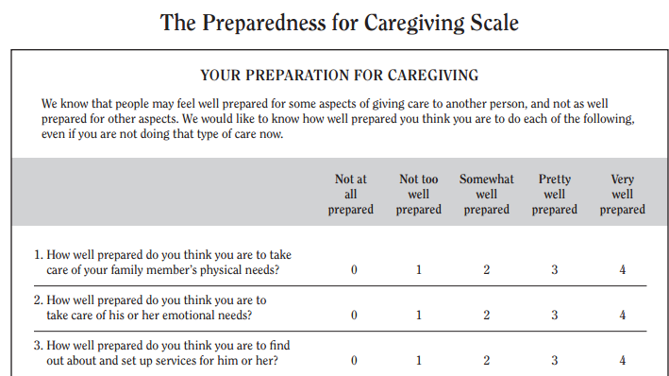
Caregiving: Tools
Preparedness for Caregiving Scale
Source: Hartford Institute for Geriatric Nursing, New York University, College of Nursing
Notes:
Dementia caregiving is a prolonged stressor for the caregiver due to the amount of time spent and the demands and expectations of the role. It is important to assess caregivers. The preparedness for caregiving scale or the modified caregiver strain index are standardized tools that help you assess the caregiver. The preparedness for caregiving tool looks at the caregivers perceptions of readiness including physical emotional needs, services, activities, and assistance from the health care system.

Slide 6
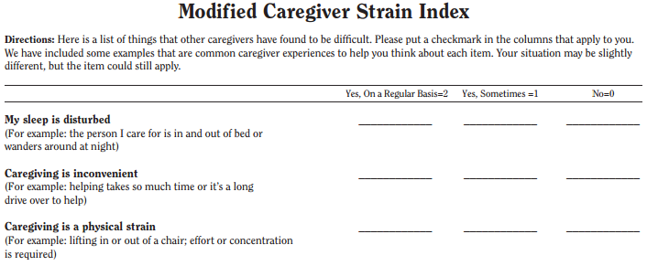
Caregiving: Tools
Modified Caregiver Strain Index
Source: Hartford Institute for Geriatric Nursing, New York University, College of Nursing
Notes:
The modified caregiver strain index examines long term family caregiver strain in the areas of financial, physical, psychological, social, and personal. However, while both the preparedness for caregiving scale and modified caregiver strain index are helpful at varying time points, it is also important to assess how caregivers are doing at present. How is their experience of caregiving? Are there challenges/barriers they are encountering? Like what? What are their needs? Is there help?
As the disease progresses, the emotional toll caregiving may take on caregivers can vary widely but should be carefully assessed. Caregivers should feel reassured that many of the emotions/feelings they experience are common (Family Caregiver Alliance – The Emotional Side of Caregiving). In addition, for working caregivers the financial toll of caregiving may also be impacted due to missed work or unpaid leave from work, as well as Family Medical Leave Act (FMLA) challenges. Further, for some caregivers who take vacations from work, they don’t really take a vacation because they use this time to provide care.
When recognizing the challenges that caregivers face or will potentially face, referrals to a social worker, or organizations such as the Alzheimer’s Association, Area Agency on Aging, as well as the Department on Aging, can help identify resources or services that may be useful to caregivers as they navigate caregiving and strategize next steps.

Slide 7
Caregiving
Family Issues
Family dynamics change over time
  Can create conflict and impede communication
  Can deepen relationships
Varied emotions are not uncommon:
  Grief
  Denial
  Isolation
  Gratitude
Notes:
Caregiving is a long term role where family dynamics may change, or arise to the surface over time with disease progression. In addition to examining how caregiving is going, understanding or inquiring about family dynamic/relationships is important too. Longstanding or newly developing conflicts may impede communication among team members. Such conflict is in addition to individualized needs/challenges associated with disease progression as well as the additional emotions that team members may experience. While varied emotions are not uncommon, additional emotional considerations include grief from watching the decline of a loved one and losing who they know; denial about the disease trajectory or the individual caregiver’s limitations; as well as isolation as a result of care required and increased distance from friends and possibly family members.
Again, recognizing the challenges that caregivers face, or will potentially face and providing additional resources, referrals to organizations, or referrals to support groups may be useful as they navigate the caregiving role.
Sources:
NASEM Families Caring for an Aging America (2016)
Quinn, Clare, McGuinness and Woods (2012). The impact of relationships motivations and meanings on dementia caregiver outcomes. International Psychogeriatrics, 24(11):1816-1826.
Paun and Farran (2011). Chronic grief management for dementia caregivers in transition: Intervention development and implementation. Journal of Gerontological Nursing
Paun, Farran, Fogg…Thomas and Hoyem (2015). A chronic grief intervention for dementia family caregivers in long term care. Western Journal of Nursing Research
Stringer, H. (2017) Lessons for Caregiving. Monitor on Psychology, 48 (2), 40-46

